Slide 1
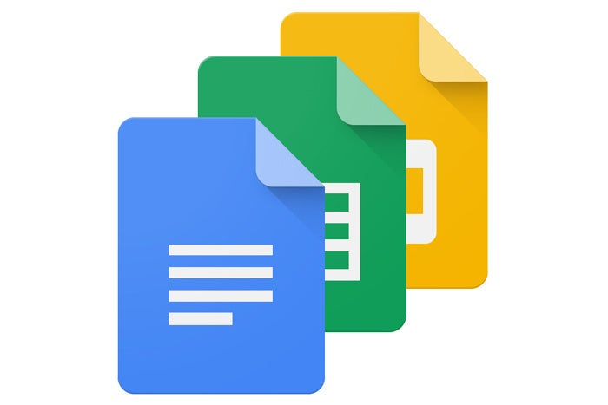
Google Docs
What is Google Docs?
Google Docs is a free word processing tool sat within Google’s online
office suite, that’s fully compatible with Microsoft Word . Users
can create, view, and edit documents online while collaborating with
colleagues in real-time – from any device, anywhere.
FYIT_45 Pankaj Kushwaha

Slide 2
How to use Google Docs
Google Docs is an online word processor that lets you create and format documents and work with other people.
Step 1: Create a document
To create a new document:
On your computer, open the Docs home screen at docs.google.com.
In the top left, under "Start a new document," click Blank New Document. .
You can also create new documents from the URL docs.google.com/create.
Step 2: Edit and format
To edit a document:
On your computer, open a document in Google Docs.
To select a word, double-click it or use your cursor to select the text you want to change.
Start editing.
To undo or redo an action, at the top, click Undo or Redo
.
Step 3: Share & work with others
You can share files and folders with people and choose whether they can view, edit, or comment on them.
FYIT_45 Pankaj Kushwaha

Slide 3
It is available as a web application supported on Google Chrome , Mozilla Firefox , Internet Explorer , Microsoft Edge and Apple Safari web browsers.
OVERVIEW
Google docs is a simple but powerful word processor for spreadsheets, presentations
etc.
Users can access all Docs, as well as other files, collectively through the Google Drive
website.
Google Docs originated from two separate products: Writely and XL2Web. Writely was a web-based word processor created by the software company Upstartle and launched in August 2005.On March 9, 2006, Google announced it.
It is a free internet tool that allow you share your document with other.
In February 2019, Google announced grammar suggestions in Docs, expanding their spell
check by using machine translation techniques to help catch tricky grammatical errors.
FYIT_45 Pankaj Kushwaha

Slide 4
Add Fonts
Google Docs Some Features
Templates
Create or Remove Headers
Clear Formatting
Create a Folder
Voice Typing
Insert Today's Date
Image Editing
Conference Calls
FYIT_45 Pankaj Kushwaha

Slide 5
Thank You
FYIT_45 Pankaj Kushwaha

